Slide 1
A Causal Inference Approach to Predict Sepsis in Patients Using Q-Learning
A Thesis Proposal by: Noah Dunn

Slide 2
Just a Few Notes Before We Get Started
I have prepared stopping blocks for questions as we go through the material
You are free and welcome to stop and ask questions at any point
If you need me to go back to a previous slide, feel free to ask and I will gladly oblige

Slide 3
Introduction
It’s always good to have a reason and a why

Slide 4
Personal Motivation
Steven Yu and I began this project with Dr. Gani in the fall of last year
I intend to pick up where we left off and conduct a formal research experiment
I want to gain as much knowledge in the field of CS to do my job(s) to the best of my ability
I find medical solutions to be of personal interest

Slide 5
Motivations
The Big Data age combined with the era of computational statistics makes coming up computer-related solutions to problems more available than ever
Testing complex algorithms and large batches of information can be done in mass with modern processors and programming languages

Slide 6
Motivations (cont.)
Hospitals and ICUs are overcrowded
Time not spent working directly with a patient in serious medical emergencies can lead to fatal consequences
Computer-assisted diagnosis is offering one solution to the issue
Doctors having the most information yields the greatest chance of taking care of a patient

Slide 7
Academic Contributions
This thesis will provide 2 contributions to the existing body of research
Provide a model that uses Q-learning techniques and existing patient data to predict Sepsis
Provide an optimization for that model using Causal Inference techniques

Slide 8
In Short
The goal is to provide a model that when given patient data as input data, generates a model using Q-Learning and a causal inference optimization. This model determines if a patient has Sepsis or not.

Slide 9
Any Questions?
Personal Motivation
Motivation
Academic Contributions

Slide 10
Sepsis
The medical condition that started this entire research exploration.

Slide 11
Life-threatening organ dysfunction caused by a dysregulated host response to infection.

Slide 12

48.9 Million Cases
11.0 Million Deaths
Ranked in Top 10 Cases of Death Worldwide
Reported in 2017
Reported in 2017

Slide 13
Two Modern Approaches
SOFA Score
Developed in 1994
6 Different Tests (One for each organ system)
Scale is 0-4 for each test
The slower and more thorough approach
quickSOFA (qSOFA) Score
Developed in 2016
1 Single Test
Scale is 0-3
The quicker and simpler approach

Slide 14
SOFA and qSOFA Scores
SOFA Score
Tests performance in
Respiratory
Coagulatory
Liver
Cardiovascular
Renal
Neurological
Systems
qSOFA Score is based on
Patient’s Systolic Blood Pressure (lower than 100 mmHg is bad)
Patient’s Respiratory Rate (more than 22 breaths a minute is bad)
Patient having an altered mental state (Scoring more than 15 points on the Glasgow Coma scale is bad)

Slide 15
Shortcomings of using SOFA and qSOFA
The SOFA score was developed on data for patients >18 years old, but young children are particularly susceptible to the disease (0-3 months old)
qSOFA leaves out metrics that SOFA includes (platelet count)
SOFA leaves out a metric that qSOFA includes (respiratory rate)

Slide 16
More importantly...
Baig et al. found that qSOFA scores outperformed SOFA scores in low-middle countries, in particular on septic shock and severe sepsis patients
Machado et al. note that qSOFA suffers from having low sensitivity (does not pick up on early stages of Sepsis), which SOFA does
If diagnosis is the goal, the tool needs to be as widely applicable as possible

Slide 17
FOOTON
Causal Inference
Set initial edge weights
Penalize models that violate causal inference
MDP
Patient Vitals
Sepsis: Yes/No
Q-Learning

Slide 18
Any Questions?
Sepsis
SOFA vs qSOFA

Slide 19
MDP
States, Actions, Rewards, Oh My!

Slide 20
An MDP provides:
States
Actions to get to Other States
Rewards/Consequences of Taking Those Actions

Slide 21
A Simple Sepsis MDP
Sys.
Blood
Pressure
?
Sepsis
0.7
?
0.6
?
Start
Age
?
0.3
0.3
?
0.4
Resp.
Rate
No Sepsis
?
0.7

Slide 22
Addressing qSOFA + SOFA Shortcomings
MDPs enable the inclusion of feature outside the vitals provided by SOFA and qSOFA as input (age being important)
MDPs enable modeling of multiple paths to the same goal
MDPs allow a quick path to diagnosis in the late stages of diagnosis (in line with qSOFA) as well as a slower, more specific path to diagnosis (in line with SOFA)

Slide 23
FOOTON
Causal Inference
Set initial edge weights
Penalize models that violate causal inference
MDP
Patient Vitals
Sepsis: Yes/No
Q-Learning

Slide 24

Q-Learning
Machine Learning for those who never look back.

Slide 25
Q-Learning is A Reinforcement Learning Algorithm
Reinforcement
Provided information when the model comes up with the incorrect response, but not why the response is incorrect.
The Model tries multiple approaches until it gets the approach correct

Slide 26
No Turning Back
Q-Learning is Off-Policy, once it makes a decision it never goes back to consult previous decisions.
It will Iterate as many times as it needs until it is done
We can use Q-Learning to provide “a best possible” solutions to several kinds of models, including Markov Decision Processes (MDPs)

Slide 27
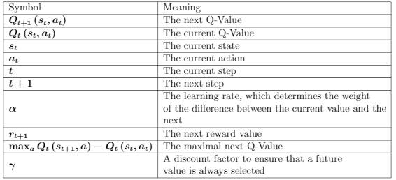
Qt+1 (st, at) = Qt (st, at) + α (rt+1 + γ max a Qt (st+1, a) − Qt (st, at))

Slide 28
Next Q-Value
Q-Value of best possible action given the current state
Qt+1 (st, at) = Qt (st, at) + α (rt+1 + γ max a Qt (st+1, a) − Qt (st, at))
Current Q-Value

Slide 29
Hyperparameter 1:
Learning Rate
Qt+1 (st, at) = Qt (st, at) + α (rt+1 + γ max a Qt (st+1, a) − Qt (st, at))
Hyperparameter 2:
Discount Factor

Slide 30
After Q-Learning
Sys.
Blood
Pressure
+0.3
Sepsis
0.7
+0.15
0.6
0.3
Start
Age
+0.25
-0.05
0.3
-0.03
0.4
Resp.
Rate
No Sepsis
-0.15
0.7

Slide 31
FOOTON
Causal Inference
Set initial edge weights
Penalize models that violate causal inference
MDP
Patient Vitals
Sepsis: Yes/No
Q-Learning

Slide 32
Any Questions?
MDPs
Q-Learning

Slide 33
Causal Inference
Why?

Slide 34
Causal Inference
It is possible to not consider causal relationships when evaluating the performance of a model
However, it is possible that training models that take existing medical knowledge into account would prove more useful
Causal inference provides this ability to a modeler

Slide 35
Using qSOFA + SOFA For Causal Inference
Q-Learning relies on models being penalized when they do not predict items output accurately
With the assumption that qSOFA and SOFA scores are good ways to predict Sepsis, two new approaches can be added to the Q-learning process

Slide 36
Using qSOFA + SOFA For Causal Inference
Weights of known causal patterns of interest (qSOFA) can be fixed to be weighted heavier than their non-causal counterparts
Models can be penalized that do not weight causal patterns of interest appropriately

Slide 37
FOOTON
Causal Inference
Set initial edge weights
Penalize models that violate causal inference
MDP
Patient Vitals
Sepsis: Yes/No
Q-Learning

Slide 38
Any Questions?
Causal Inference
Using qSOFA + SOFA

Slide 39
The Endgame
When are we done and how did we do?

Slide 40
Research Roadmap
Gather and construct a full dataset to do testing on (from public data)
Optimize the MDPs + Models with Causal Inference Techniques
Data
Optimizing
Modeling
Build MDPs and test them with Q-Learning techniques

Slide 41
Previous Work
RESEARCH GROUP | MODEL TYPE
PhysioNet Winner | Signature-Based Regression Model Mix of Supervised + Unsupervised
Komorowski et. al AI Clinician | Stock Q-Learning from MatLab
Raghu et. al | Dueling Double Deep Q-Learning
Raghu et. al Optimization | DDQN and Sparse Autoencoder DDQN
Peng et. al | MOE (DDQN + KRL)
Petersen et. al | Stock Deep Q-Learning on Cytokines
Tsoukalas et. al | POMDP + Perseus Algorithm

Slide 42
Difference In This Experiment
Other approaches have used Q-Learning, and MDPs
This experiment is closest in nature to Komoroski et al.
However, the inclusion and usage of causal inference techniques to enable better Q-Learning has not been done, to my knowledge and reading, with respect to diagnosing Sepsis

Slide 43
Difference In This Experiment (cont.)
In addition, the majority of the related work to this problem has taken on the question of diagnosis, rather than the standard of treatment
By proposing a pure diagnostic model, the goal is to increase accuracy in the model that would be lost building a more complex solution for diagnosis

Slide 44
Data Source: MIMIC-III
> 1 Decade of anonymized medical records
Publicly available, but requires certificate (That I have)
Data is very sporadic and is loaded with inconsistencies
Komorowski et. al have scripts to extract, cleanse, and specify Sepsis data from the database
Komorowski et. al was able to extract 17,083 ICU patients from 5 ICUs in their research using MIMIC-III

Slide 45
Building the Initial MDPs
The Komorowski et. al scripts build MDPs using a Clustering technique called ‘k-means++’
In our context, K-Means++ fixes groups of patients based on criteria from time-series data
They have provided scripts which build 500 distinct MDPs from a provided data set.

Slide 46
Implementing Q-Learning
MatLab has a Q-Learning Toolbox available free to the public online
Much of the existing work (including the Komorowski et. al research) makes use of MatLab scripts

Slide 47
Cross Validation
In order to test the quality of just the MIMIC-III data, Cross Validation techniques can be employed.
Cross Validation grabs a small subset of the existing data, and tests the current model against it for how well it performs

Slide 48
Hyperparameter Optimization
In the Q-Learning equation shown before, the discount factor( ƛ ) and the rate of learning ( ɑ ) are what are called ‘Hyperparameters’, or values that are set prior to conducting the learning

Slide 49
Hyperparameter Optimization (cont.)
There are a number of approaches for optimizing these values
Grid Evaluation: Provide a set list of all possible values and validate how they perform
Random Selection: Pick values purely at random and test
Q-Learning: Use a parallel Q-Learning algorithm to train for optimal hyperparameters

Slide 50
The Approach for this Research
Since there are only 2 hyperparameters for this equation, I would like to start out with the grid approach
If performance time becomes an apparent issue, I will switch to another method

Slide 51
Improvement by Simplification (cont.)
Prior to talking with Dr. Giabbanelli, I did not know the concept of feature selection. I was only aware of manual selection from my Statistical Modeling course
Feature selection is an automated way to simplify models, keeping only the relevant factors that have a significant impact on the output
I think this approach will offer elimination of unnecessary factors that will be provided by the initial data set

Slide 52
Stopping Criteria
Once Q-Learning has been performed on all MDPs using the Causal Inference techniques, and models have been simplified using feature selection, the experiment will be declared concluded

Slide 53
Evaluation Methodology and Metrics
The following are standard Machine Learning metrics used for evaluation:
Recall -> True Positives / (True Positives + False Negatives)
Precision -> True Positives / (True Positives + False Positives)
F1 Score -> 2 * ((precision * recall) / (precision + recall))
ROC Curve -> Plots true positive rate on the y-axis, and false positive rate on the x-axis

Slide 54
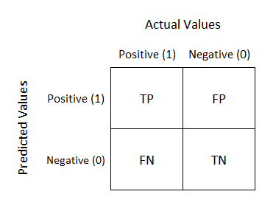
Evaluation Methodology and Metrics
CONFUSION MATRIX :

Slide 55
Dissemination Of Results
Some offerings of potential conferences for final submission by Dr. Rao:
ACM Transactions on Modeling and Computer Simulation (TOMACS)
Simulation: Transactions of the Society for Modeling and Simulation International
Frontiers In Artificial Intelligence

Slide 56
Dissemination Of Results (cont.)
Some offerings of potential conferences for final submission by Dr. Giabbanelli
Journal of Medical Internet Research (JMIR)
BMC Medical Research Methodology
International Journal of Medical Informatics
BMC Medical Informatics and Decision Making
EPJ Data Science
ACM Transactions on Data Science

Slide 57
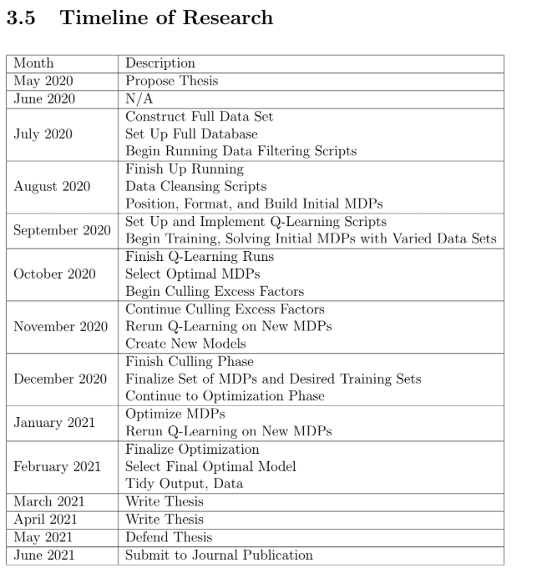

Slide 58
Any Questions?
Stopping Criteria
Eval. Methodology + Metrics
Dissemination of Results
Timeline

Slide 59
Final Thoughts
The end and the future

Slide 60
Conclusion
The end of the experiment will yield a model, built with Q-Learning and Causal Inference, that predicts whether or not a patient has Sepsis based on their data
The result will yield an indicator of the feasibility of this approach for future diagnosis models

Slide 61
Future Work
This proposal is the launchpad for the full thesis and experiment
Hopefully, much of what has been presented today will make it into the final paper that concludes my Master’s studies.
It is my goal that the work I invest in this experiment will be used by further researchers to solve the Sepsis problem for good and save as many lives as possible

Slide 62
Giving Credit Where Credit is Due
This entire presentation’s theme was provided by SlidesCarnival under the Creative Common’s License.
Also several of these slides follow stylistic guidelines and examples provided by SlidesCarnival
Icons provided by FontAwesome also under CC

Slide 63
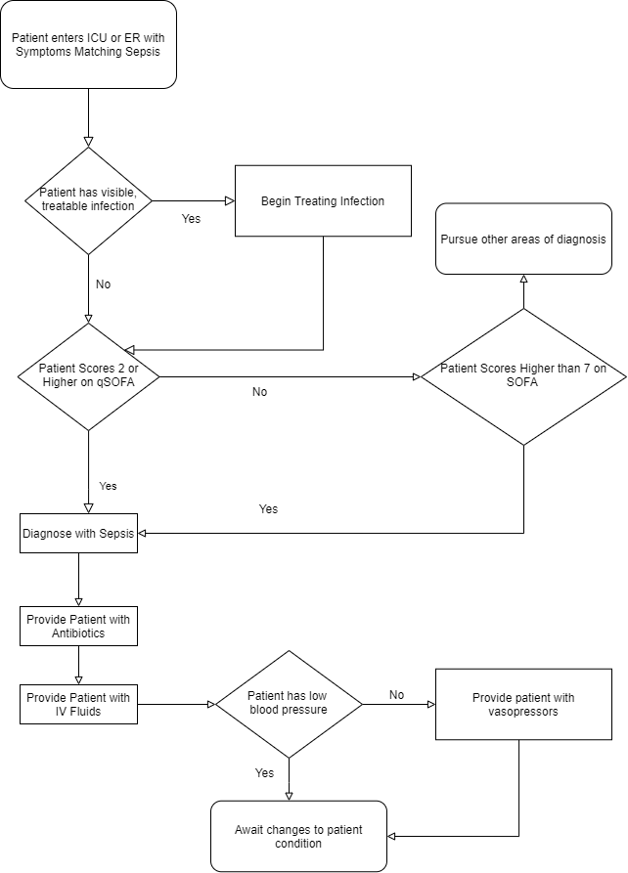
A Flowchart of the full Sepsis diagnosis + treatment process

Slide 64
Data Source 1: PhysioNet Sepsis Data
Composed of two data sets: A and B
A contains information on 20,336 subjects
B contains information on 20,000 subjects
Data is publicly available
Offers information on a patient throughout the course of a day, including their Sepsis status

Slide 65
Data Source 1: PhysioNet Sepsis Data (cont.)
Gathered from 3 Hospitals
Over a timespan of around a decade
Data comes from three different EMR systems (Electronic Medical Record) from three different hospitals
The hospitals in question:
Beth Israel Deaconess Center (Boston, Massachusetts)
Emory University Hospital (Druid Hills, Georgia)
An Unidentified Hospital

Slide 66
Initial Q-Learning Combinations
TRAINING SET | VALIDATION SET
A or B | MIMIC-III
A and B | MIMIC-III
MIMIC-III | A or B
MIMIC-III | A and B

Slide 67
There is a Problem
The training set and testing set must have the same number of factors/labels in order to proceed with accuracy
They are not one to one
There are two solutions to this issue

Slide 68
Potential Solutions
Use one or the other, but not both (likely MIMIC-III, due to its ICU diversity)
Only include the data that exists in both area in the models

Slide 69
Which is Better?
For now, the experiment will be conducted on MIMIC-III alone, as the data cleansing scripts, Sepsis-III extraction, and as we are about to see MDP generation scripts already exist for this data set
Should additional data be required in the future, I am going to consult Dr. Giabbanelli on how best to prepare these kinds of models

